Slide 1
Community Health and Wellbeing
Lucy Bird – Health and Wellbeing Officer Worcestershire CALC
‘Communities make a vital contribution to health and wellbeing. The assets within communities, such as skills and knowledge, social networks and community organisations are all building blocks for good health.’- Being Well in Worcestershire

Slide 2
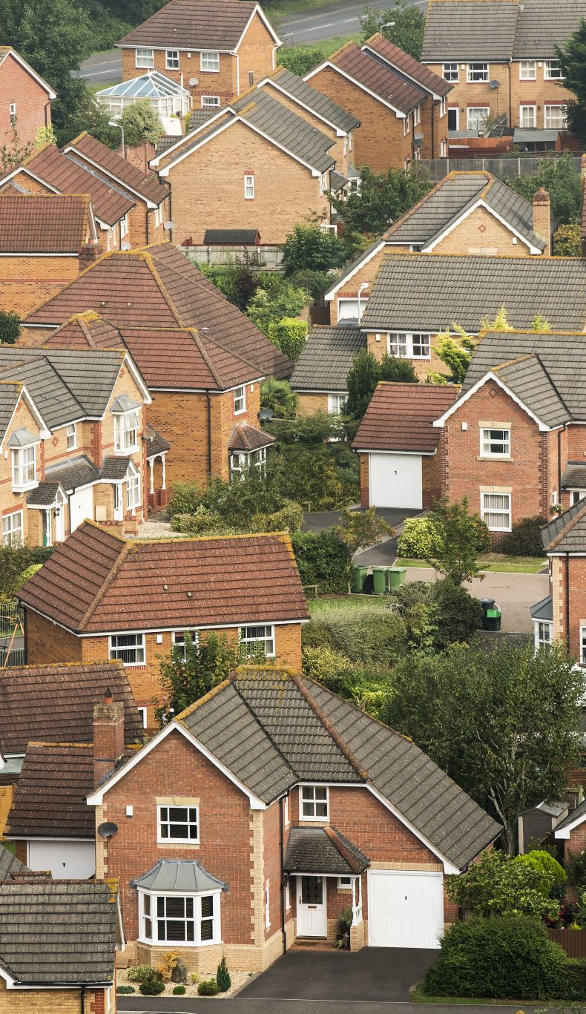
Town and Parish Councils
As the most local tier of government, Town and Parish Councils are uniquely placed to understand and address the specific needs of their residents.
By focusing on community health and wellbeing, Town and Parish Councils can help create vibrant, connected, and supportive environments that enhance the quality of life for everyone.
Have a vast array of local resources such as community venues, green spaces and most importantly… the people.

Slide 3
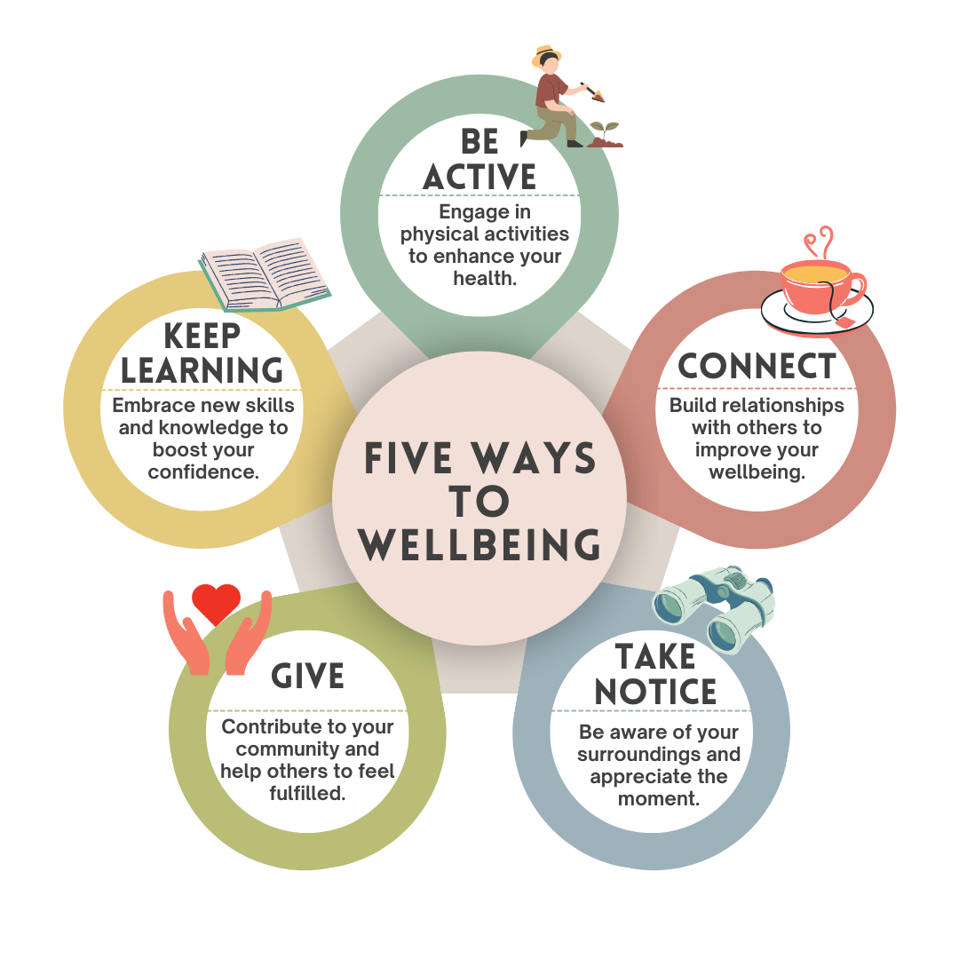
What is Community Health and Wellbeing?
Community health and wellbeing goes beyond physical health. It’s about fostering a sense of belonging, mental resilience, social inclusion and access to local resources.
Physical Health
Mental Wellbeing
Social Connectivity
Environmental Health
Health Education and Resources

Slide 4
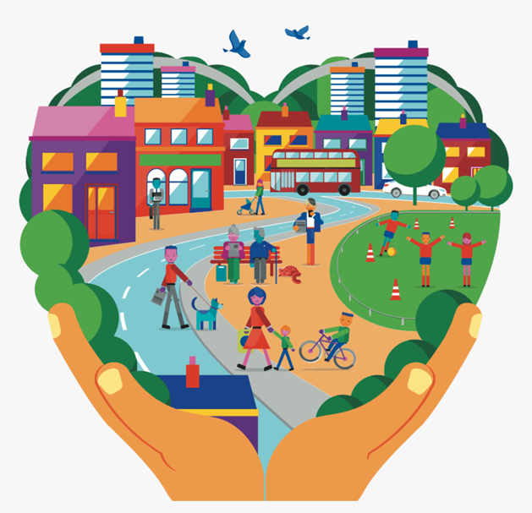
How can local Councils support Community Health and Wellbeing?
Focus on several themes:
Communication and engagement
Community activities and events
Green spaces and recreation
Support networks and accessibility
Mental health support
Local advocacy and partnerships

Slide 5
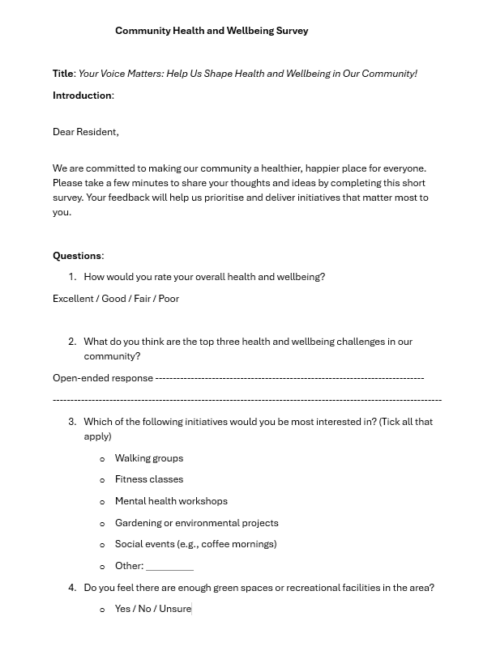

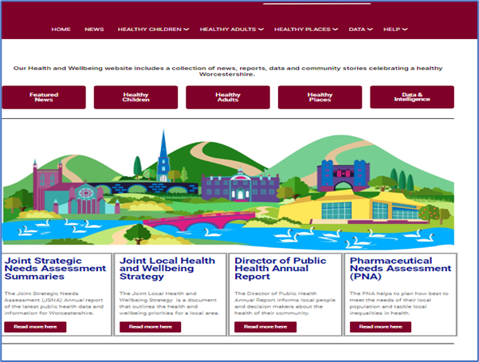
Understanding the community
Active community engagement
Surveys
Insights data (Worcestershire County Council)

Slide 6
Community Activities and Events
Develop
Develop a Community Health and Wellbeing Calendar
Support and organise
Support and organise activities where there are gaps – using an asset-based approach work with community members and key organisations.
Encourage
Encourage participation in communal activities.

Slide 7

Green Spaces and Recreation
Create an environment that lends itself to positive healthy lifestyles.
Maintain and enhance parks, allotments and recreational facilities to encourage outdoor activities.
Develop walking and cycling paths to promote active travel and exercise.

Slide 8
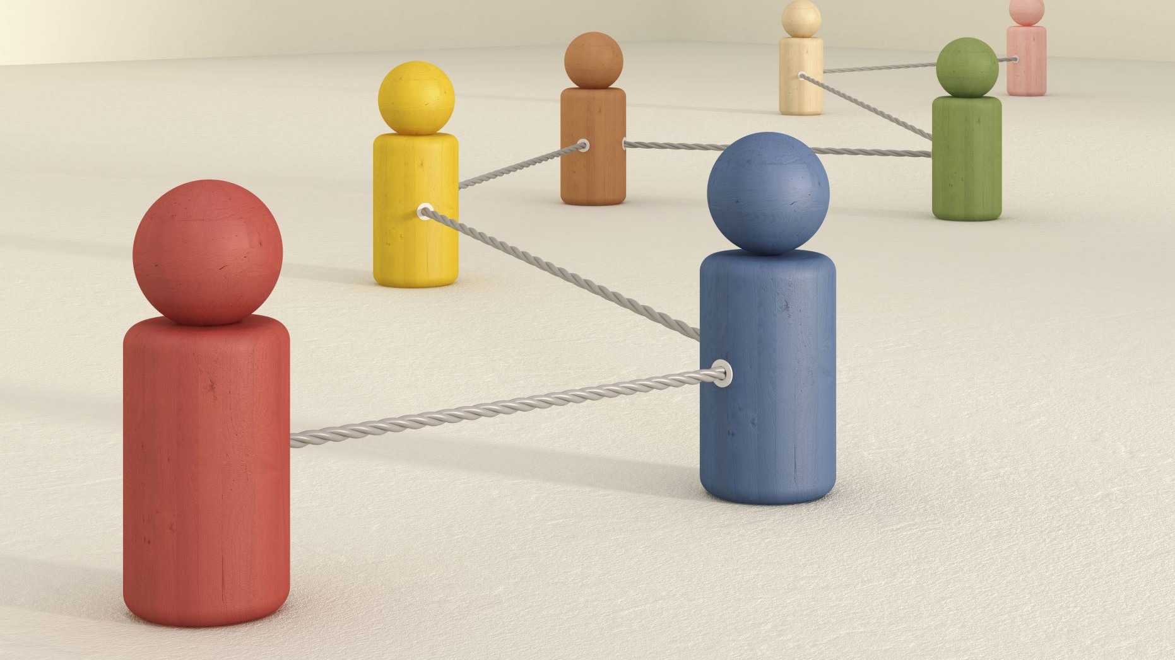
Support networks and accessibility
Establish community groups for vulnerable residents, such as the elderly, young parents, or those with disabilities.
Develop community networks for groups and organisations to work together and to be able to signpost where possible.
Collaborate with local charities and organisations to provide accessible health and wellbeing resources.

Slide 9
Positive Mental Health Support
Partner with mental health organisations to provide workshops and training for residents.
Promote awareness campaigns to reduce stigma and encourage open conversations about mental health.

Slide 10
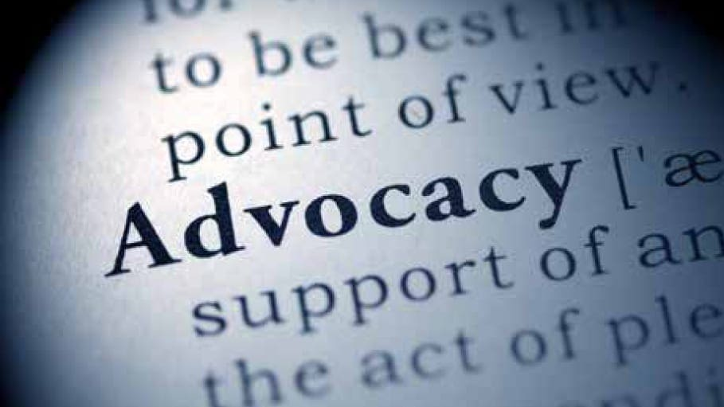
Local advocacy and partnerships
Act as a voice for the community, advocating for improved health and wellbeing services.
Partner with healthcare providers, schools, and businesses to implement joint initiatives.

Slide 11
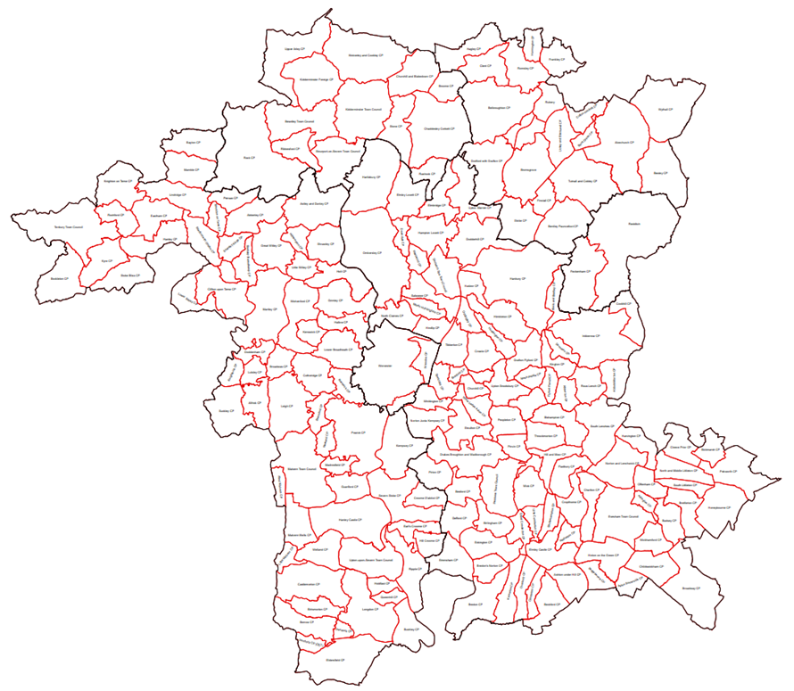

The Worcestershire CALC offer
Health and Wellbeing support.
  Online Toolkit – Worcestershire CALC/Health and Wellbeing https://worcscalc.org.uk/health-wellbeing
  One-to-one support for Town and Parish Councils
  Training opportunities
  Building connections and networks

Slide 12
Case Studies
Peterlee Town Council, County Durham, introduced Taste Buddies to encourage members of the community experiencing loneliness to come together on a weekly basis.
Milton Parish Council, Cambridgeshire, runs a well-regarded Community Warden scheme. Elderly and infirm residents can sign up to receive regular social contact from the community care warden, including daily contact and a personal visit at least once a week.
Haverhill Town Council, Suffolk, are an integral part of Haverhill Lifelink, which helps address social and wellbeing needs of residents which can also impact on health.
Hythe Town Council, Kent started The Dementia Awareness Forum, which aims to bring awareness to its residents of the people living in the town and the needs of their carers.
Reproduced, by permission, from the National Association of Local Councils. Copyright © NALC 2025 (https://www.nalc.gov.uk/resource/health-and-wellbeingcase-studies.html)

